Slide 1
Gauss-Jordan Elimination Method with a Real-Life Example

Slide 2
Gauss-Jordan Elimination
Gauss-Jordan Elimination is a step-by-step method used to solve a system of linear equations
by transforming the augmented matrix into Reduced Row Echelon Form (RREF) using row operations.

Slide 3
🔹 Steps of the Method:
Form the augmented matrix of the system.
Make the leading entry (pivot) in each row a 1.
Make all other entries in the pivot's column 0.
Continue until the matrix is in RREF, then read off the solution.

Slide 4
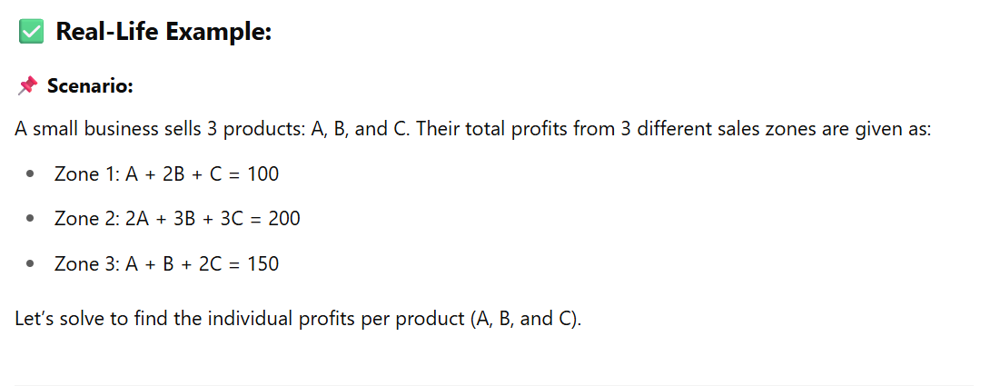
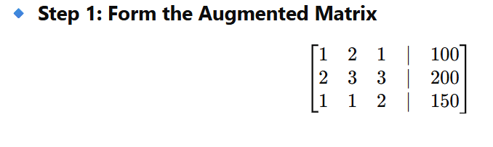

Slide 5
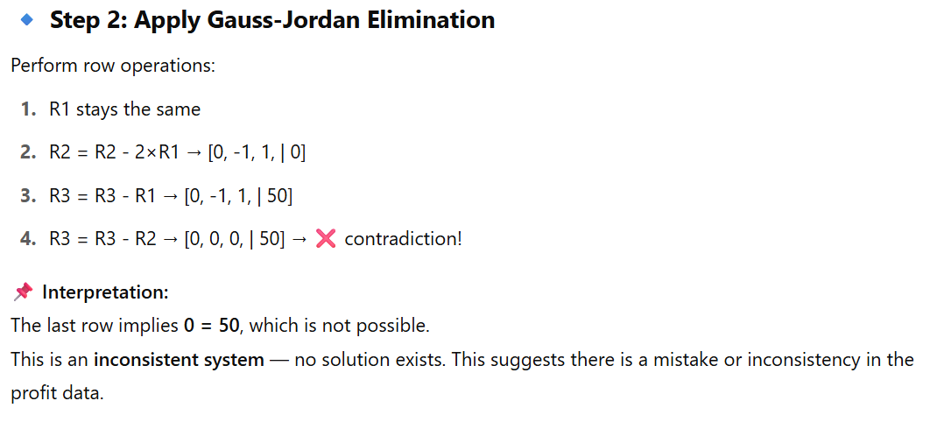

Slide 6
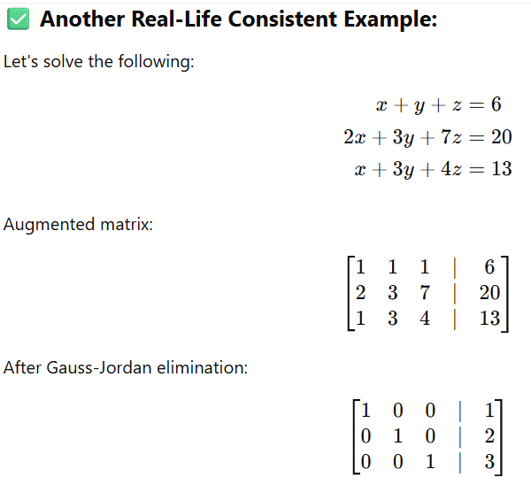

Slide 7
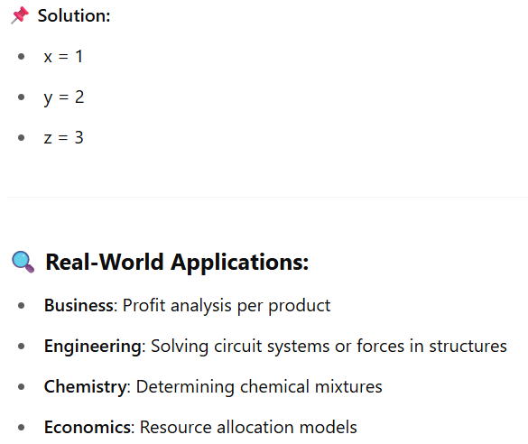

Slide 8
Gauss-Jordan Elimination method vs Elimination

